Slide 1
Luganda voice-controlled wheelchair
Okiror Samuel Vinald
Ankunda A Adi

Slide 2
Recap
The main objective is to develop a Luganda voice-controlled wheelchair system
Specific objectives
To collect and curate a Luganda voice dataset for common wheelchair movement commands.
To develop, train and evaluate a speech intent recognition model to classify spoken Luganda commands.
To integrate the trained model with a wheelchair to form a voice-controlled wheelchair system.
To evaluate the system.

Slide 3
Work completed
Training the English model
The dataset used is a Kaggle dataset titled “speech_commands_vO.02”
The model was trained on six classes ('forward’, 'no’ ,'left’, 'stop’, 'backward’, 'right’) with each class having 1,000 transcriptions
Each audio file has a duration 1s, mono channel, and rate of 16kHz.
We extracted spectrogram to train the model

Slide 4
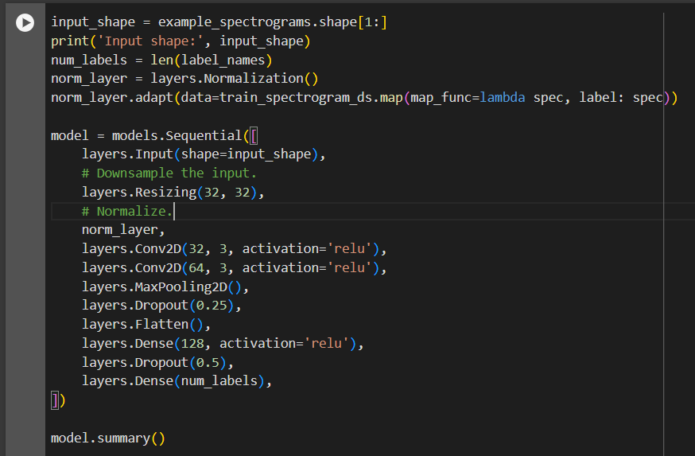
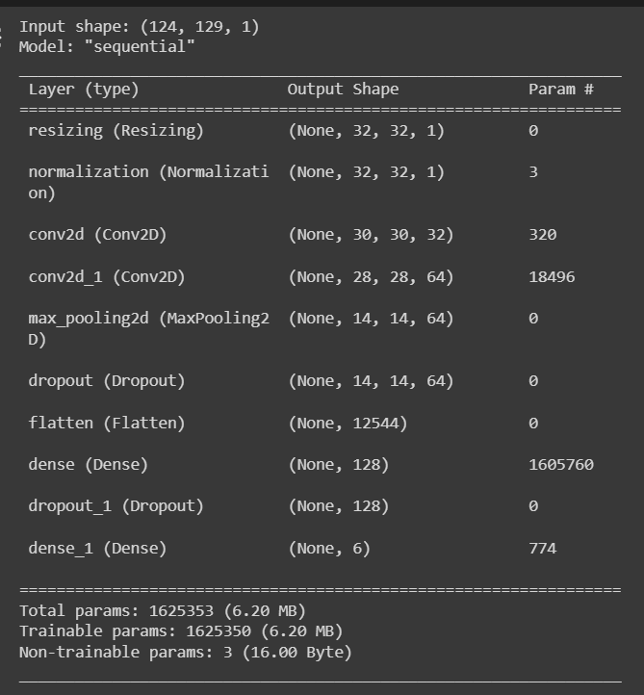
Model

Slide 5
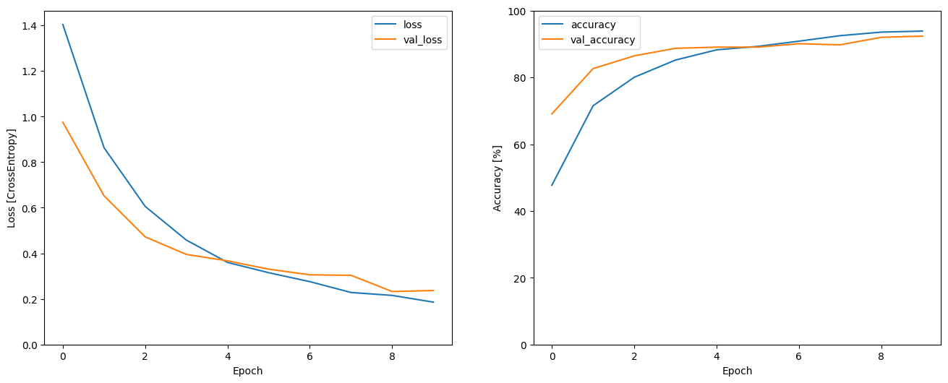
History plots

Slide 6
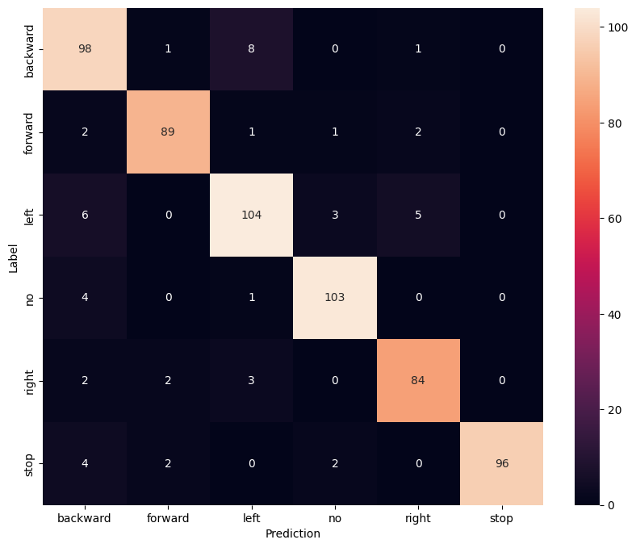
Confusion matrix

Slide 7
Details of the audio data
We are collecting data on 5 classes (“mu maaso”, “emabega”, “yomirira”, “ddyo” and “kkono”) and the wake word “Gaali” which are illustrated in table 1: classes.
Each class has 5 transcriptions.
Target is to collect audio samples from 100 people
The audio file has mono channel audio, sample rate of 16000Hz, .wav format and duration of <3s.
Currently we have 312 samples per word.

Slide 8
Table 1: Classes
Command classes
Left | Kkono | Dda ku kkono | ku kkono | Kyukira ku kkono | Weta ku kkono
Right | Ddyo | Dda ku ddyo | ku ddyo | Kyukira ku ddyo | Weta ku ddyo
Forward | Mu maaso | Dda mu maaso | Mu maaso awo | Weeyongere mu maaso | Genda mu maaso
Backward | Emabega | Dda emabega | Emabega awo | Okudda emabega | genda emabega
Stop | Yimirira | Okuyimirira | Yimirira awo | Gwe yimirira | Kaati yimirira
Wake word | Gaali | Gaali | Gaali | Gaali | Gaali

Slide 9
Hardware components
Board | Raspberry Pi
Microphone | reSpeaker 2-Mics Pi HAT or Mems Microphone Module
Motor driver | L298N Motor Driver Board
Motors | G12-N20 Geared Mini DC Motor
Speaker

Slide 10
Current status
Collecting audio data
Working on the proposal report

